Slide 1
Divisions of the Nervous System

Slide 2
SCSA Says - Comparisons
Central vs Peripheral
Autonomic vs Somatic
Afferent vs Efferent
Sympathetic vs Parasympathetic

Slide 3
PNS - Cranial and Spinal Nerves
The PNS can be summarised as 43 pairs of nerves (a bundle of nerve fibres).
12 pairs are cranial nerves – they arise from the brain e.g. optical nerve.
31 pairs are spinal nerves – they arise from the spine. They have a dorsal root (axons of sensory neurons) and they have a ventral root (axons of the motor neurons).

Slide 4
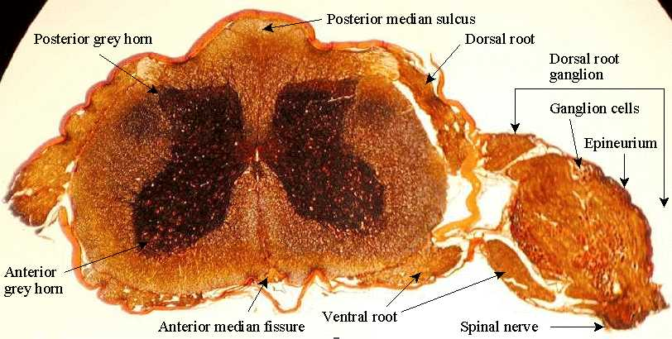

Slide 5
Divisions of the PNS
By function we can make some organisational divisions that help in the study of the PNS:
Afferent (sensory) division – the fibres that carry impulses into the CNS. Divided further:
Somatic: carry impulses from receptors around the muscles/joints and skin to the CNS
Visceral: carry impulses from the internal organs to the CNS

Slide 6
Divisions of the PNS
Efferent (motor) division – the fibres that carry impulses away from the CNS. Divided further:
Somatic: carry impulses to the skeletal muscles from the CNS
Autonomic: carry impulses to the heart and other involuntary muscles and glands. Two further subdivisions:
Sympathetic division: produce responses required in strenuous activity
Parasympathetic: produce responses that maintain the body during quiet/restful conditions.

Slide 7
